Slide 1

Around the world in grapey days
October 5, 2017
Bryan, Paige, Felder, Meyappan, Aishwarya

Slide 2
Key Business Questions
To evaluate pricing structure of wines and recommend reorganizing of liquor stores based on similarities between wine varieties
How can expert reviews be used to improve recommendations for liquor stores?
Are stores overpricing or underpricing their wine?
Are stores aware of the attributes used to describe their wine? Are they advertising it right?
Can we make wine suggestions to restaurants based on purchase history and menu?

Slide 3
Data Description
<something about the dataset>
KEY STATISTICS
Here are some key statistical highlights about the dataset being used
151k
Wine Reviews
15k
Wineries
632
Wine Varieties
<#>
Attributes
Where?
The data was scraped from WineEnthusiast during the week of June 15th, 2017
What?
The dataset contains descriptions, prices, and points given to each type of wine, varying by variety, region, and winery

Slide 4




Approach
A four-step approach was implemented to achieve business goals
Preprocessing
Remove undesirable characters(@,!, etc)
Remove stopwords
Analysis
Calculate lift values of top 25 wine varieties against top 20 attributes
Vectorize each variety and calculate cosine similarities
Insights
As
df
Recommendations
reco 1
Reco 2

Slide 5
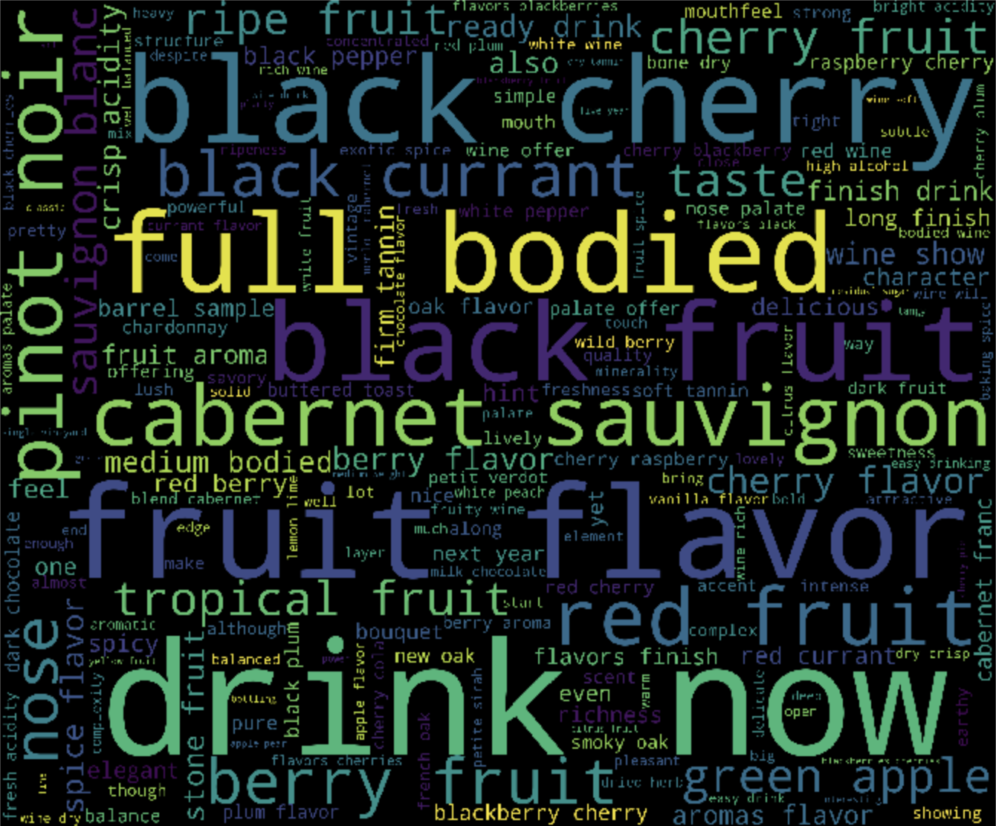
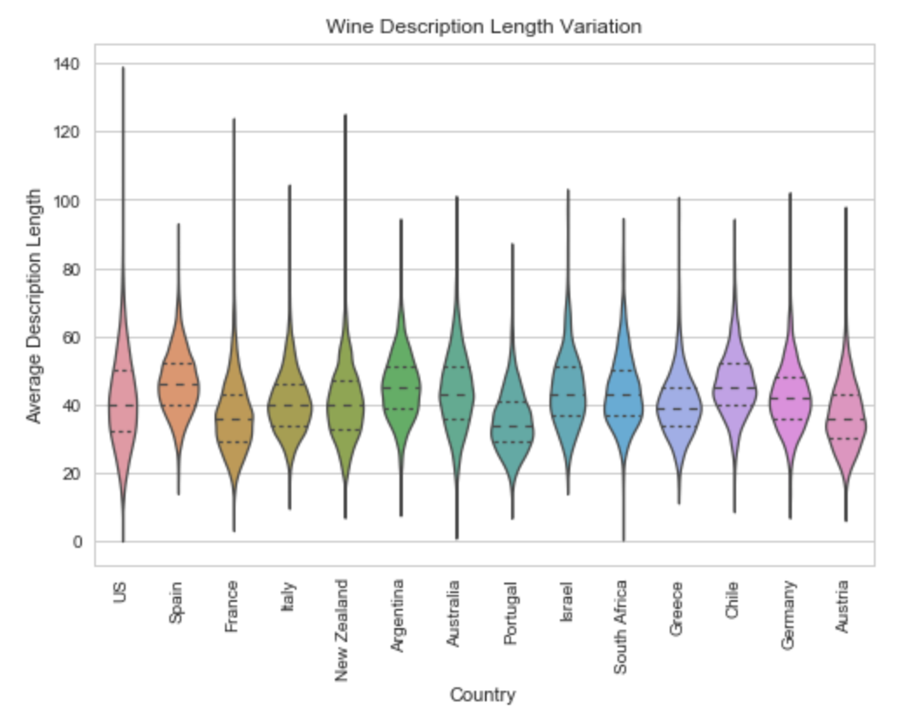
Exploratory Data Analysis
Most frequent attributes used to describe types of wine
Something about this graph

Slide 6
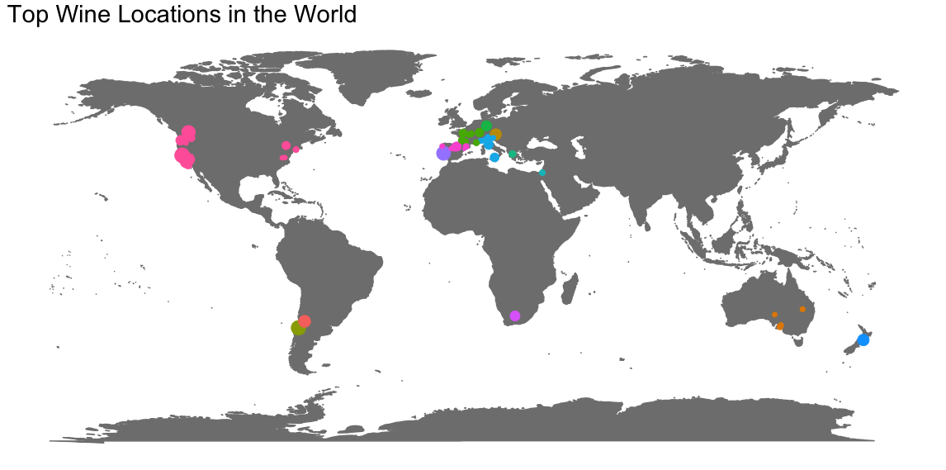
What are the top wine locations in the world?

Slide 7
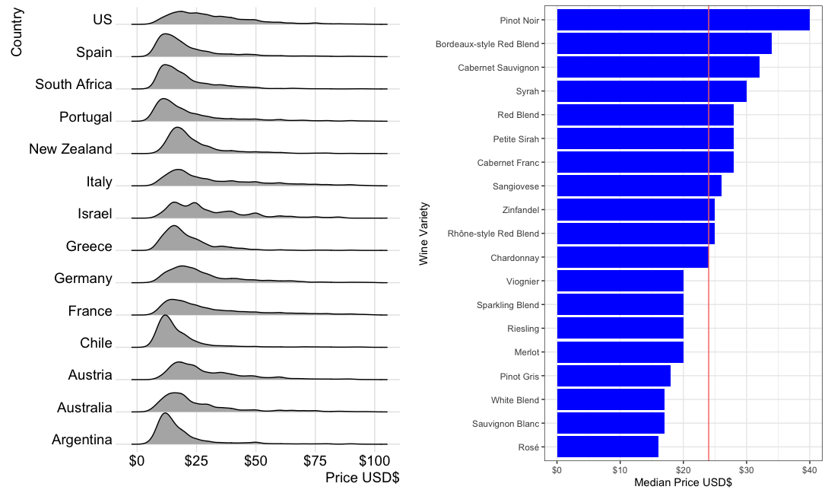
What is the current pricing structure of wines?
By country
By variety

Slide 8
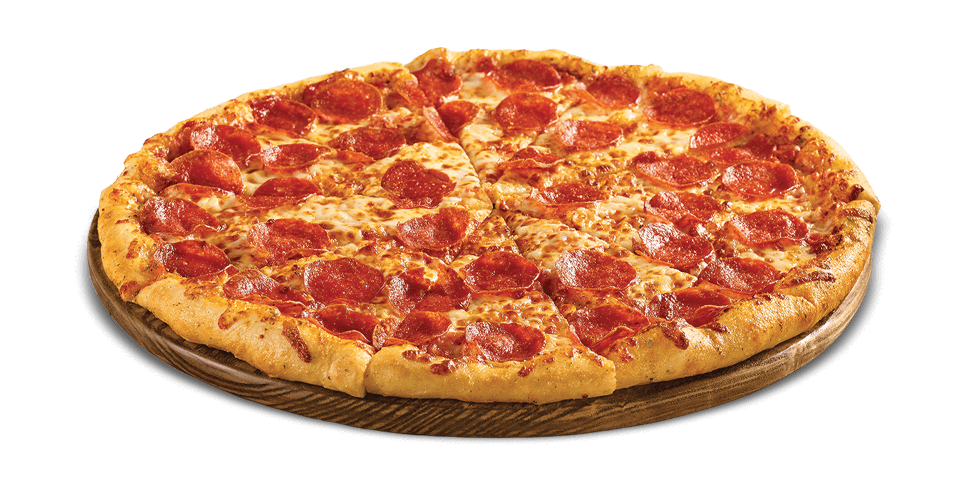
What is average rating when each of these foods are mentioned?
Cheap Chow
Fancy Food
The avg. rating is 0.74 SD above the mean
The avg. rating is 0.98 SD below the mean
The avg. rating is 0.72 SD below the mean
The avg. rating is 0.52 SD above the mean
The avg. rating is 0.64 SD below the mean
The avg. rating is 0.36 SD above the mean
The avg. rating is 0.53 SD below the mean

